Slide 1
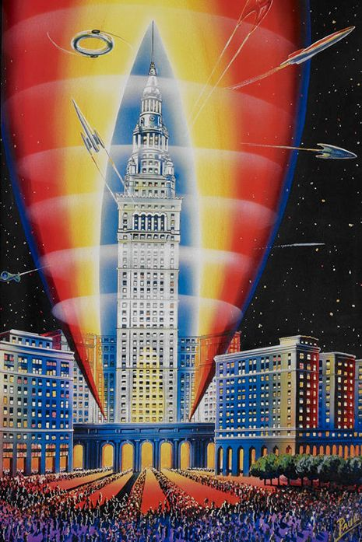
Cleveland
City of the future – of the past

Slide 2
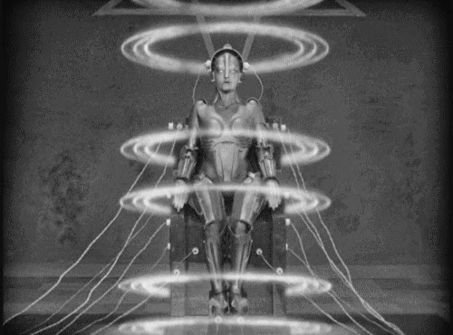
The Electric Future: 1920-1930
Mass produced technologies vastly change social landscape.
Art Deco / Modernism / film / feminism
Notable works: Metropolis (book and movie), Orlando, Frau im Mond
Popular reprints of “Adventure Fiction” like Verne and Hugo
Hugo Gernsbeck coins term “scientificition” to differentiate what we will call science fiction from other adventure stories, founds Amazing Stories

Slide 3
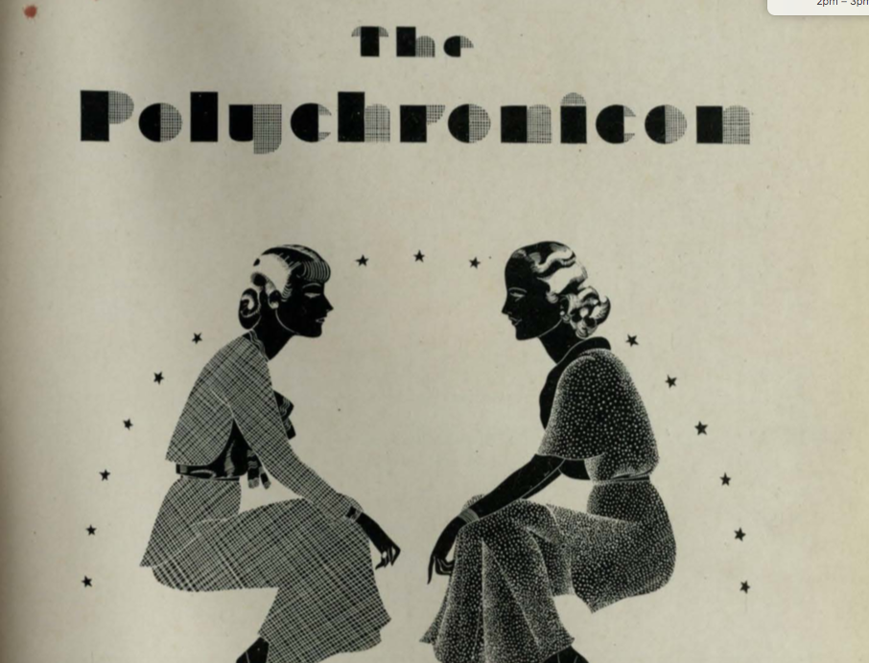
In Cleveland
Period of tremendous growth
Birth of cultural institutions
College for Women grows exponentially
Kokoon Arts Club
Karamu Theatre
Clare Winger Harris
First woman to publish SF under own name – 1928
Moved to Cleveland around then, until 1933
J. Paul Suter of Youngstown publishes pulp stories
Weird Tales and others – mystery and horror
Cover, 1930 WRU College for Women yearbook

Slide 4
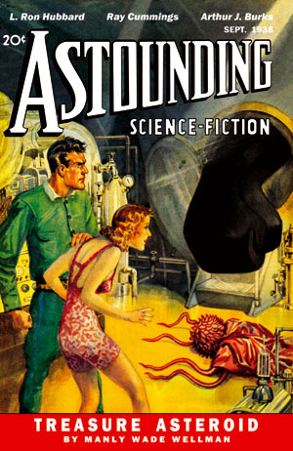
The Golden Age: 1930s and 40s
Astounding founded in 1930
Amazing, Astounding, Weird Tales all thrive and magazine prices actually go down
John Campbell becomes editor of Astounding in 1938
Advances in affordable printing result in mass market paperbacks, comic books
Dawn of the superhero

Slide 5
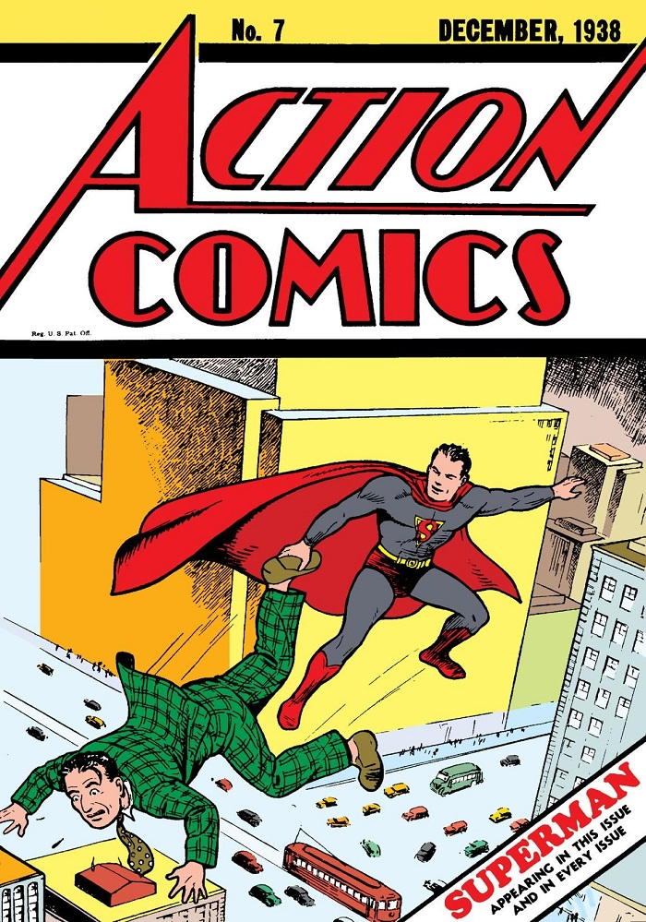
Golden age Cleveland
Joe Shuster and Jerry Siegel’s Superman in Action Comics 1938
Andre Norton publishes her first novels “The Prince Commands” in 1934 “Ralestone Luck” in 1938
Jean Milligan of Cleveland sells 33 short stories to Weird Tales and other magazines from 1943 to 1951 under the pen names Allison V. Harding and Alice B. Harcraft

Slide 6
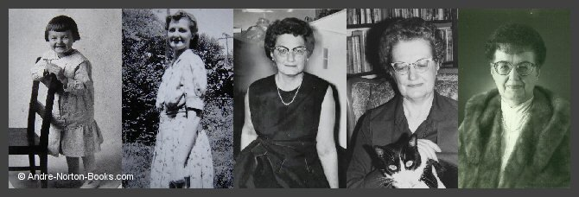
Andre Norton
Born Alice Norton, changed name after fame. 30 well-received novels, 24 novel series, and countless short stories
Science Fiction Writers Association Grand Master, Hall of Fame Member SFWA’s Young Adult award is The Andre Norton Award
Attended WRU in 1930
Worked at Cleveland Public Library
Known for “Witch World”, “Crosstime”, “Beastmaster”
Played D&D with Gary Gygax – to research what might be the first ‘gamers fall into the game’ novel - mentioned by him in 1st Ed. Appendix as an author whose works inspired the lore!

Slide 7
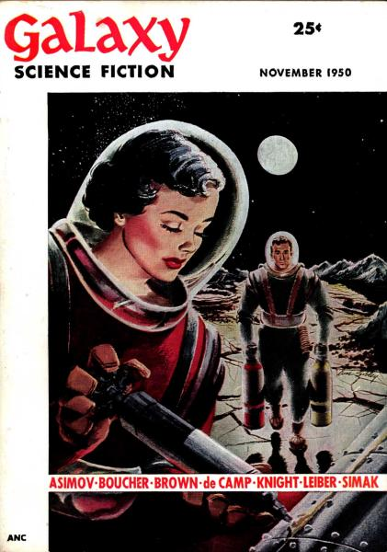
The Silver Age – 1950s and 60s
(Silver/Gold distinction mine.) “The Golden Age of Science Fiction is thirteen.”
Founding of “Fantasy & Science Fiction” in 1949 and “Galaxy” in 1950 – the old pulps have new competition!
Campbell changes the name of “Astounding” to “Analog Science Fiction and Fact” in 1960
Rise of Television
Space Race makes science fiction relevant and mainstream

Slide 8
13th world Science Fiction Convention: The Clevention - 1955
Two Cleveland World Science Fiction Conventions in the Silver Age!
About 380 attended at Cleveland’s Manager Hotel
First convention to establish the Hugos as an annual award.
John W. Campbell wins Hugo for Astounding Magazine
Isaac Asimov is Guest of Honor
Chairs: Nick and Noreen Falasca

Slide 9
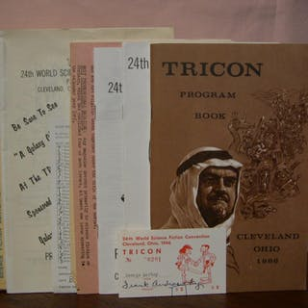
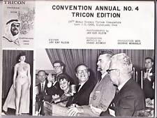
24th World Science Fiction Convention 1966
About 850 attended at the Sheraton
Local author Roger Zelazny wins Hugo for novel “…And Call Me Conrad” (tied with ”Dune”)
Another local, Harlon Ellison, takes the Hugo for short story “’Repent, Harlequin!’ Said the Ticktockkman”
Gene Roddenberry premiered both pilot episodes for his upcoming TV series “Star Trek” (Wife Majel Barrett born in Cleveland)

Slide 10
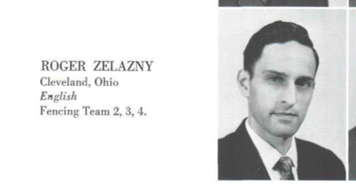
Roger Zelazny
Graduated WRU with BA in English in 1959
Hugo winner (as mentioned)
Fencer!
Known for his Amber series
Novel “Doorways in the Sand” takes place on a college campus that will feel very familiar to CWRU students.

Slide 11
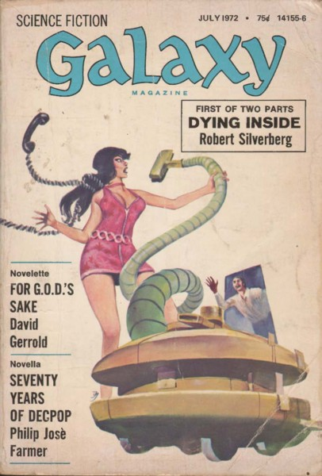
The 1970s and 80s: Dystopia and Social Change
Changing demographics and social upheaval turn attention to social change more than technological change
Magazine circulations declines as more people read trade paperbacks for their fiction – Series Novels / media tie-ins are king (and dominate to this day.)
Film effects make filming science fiction concepts easier – Star Wars shakes the world
Disconnect between Sci-Fi media and the written genre

Slide 12
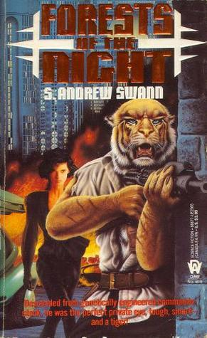
70s and 80s Cleveland Science Fiction
S. Andrew Swann’s ”Forests of the Night” series
Howard the Duck
CWRU film society founded in 1970! (First Science Fiction Marathon in 1976)
Founding of the Cajun Sushi Hamsters

Slide 13
Cajun Sushi Hamsters from Hell
Founded in 1986 by Mary Turzillo (Nebula winner)
Geoff Landis acts as group secretary – Mary’s husband and winner of three Hugo awards
Other notable past / present members:
Tobias Buckell (Campbell, Nebula nominations, NYT bestseller)
Astrid Julian
Ellen Klages (Nebula)
Maureen McHugh (Hugo)
Charles Oberndorf (Tiptree, Locus nominations)
Catherynne Valente (Hugo nomination)
Ferret Steimetz
S. Andrew Swann
Sarah Willis
Marie Vibbert

Slide 14
The 90s and 2000’s: Dawn of the Net
New focus on the mind and artificial realities
Experimental “Hyper Novels”
Average book lengths grow astonishingly as consumers purchase doorstops from Steven King and Tad Williams. Trilogies of the 70s and 80s re-issued as single volumes.
Mary Doria Russell’s “The Sparrow” in 1996 wins Arthur C. Clarke, Tiptree Awards, she worked for the CWRU school of Dental Medicine teaching anatomy.

Slide 15
Today: A New golden age?
International Science Fiction flourishing due to greater ease of collaboration with translators, electronic distribution
Rise of the electronic magazines: Clarkesworld, Strange Horizons, Lightspeed – their hit-rates are far higher than any print magazine subscription roll.
New prominence of the novella Tor.Com, Apex Books, ebooks – electronic readers less concerned with spine thickness!
124 authors in the Internet Science Fiction Database list “Cleveland, OH” as birthplace
The Submission Grinder lists 22 pro-rate Science Fiction markets open RIGHT NOW to submissions.

Slide 16
Notable Science Fiction Books set in Cleveland
S. Andrew Swann “Dragons of the Cuyahoga”, “Dwarves of Whiskey Island”, “Forests of the Night”
Charles Oberndorf “Sheltered Lives”
Roger Zelazny “Doorways in the Sand”
Thomas Pynchon “Against the Day” (has a scene at CWRU)
Fritz Leiber “The Creature from Cleveland Depths and Other Tales”
Geoff Landis “Mars Crossing” (some scenes)
Mary Doria Russell’s “The Sparrow” (some scenes)

Slide 17
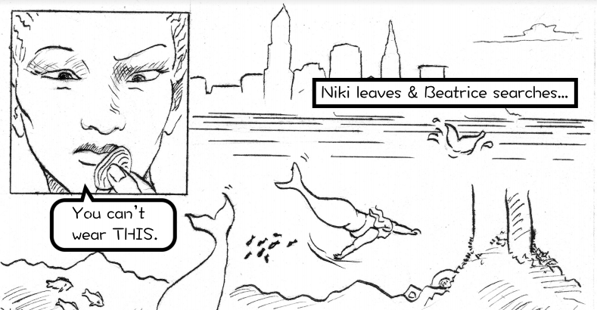
Cleveland in comics
Brian Michael Bendis
– draws, like, everything,
but mostly known for Spider-Man
Steve Gerber’s “Howard the Duck”
Ted Sikora’s “Apama” series
“Paper Girls” from Image by Brian K. Vaughan
“The Escapists” Brian K. Vaughan – great work on Cleveland’s comic history as a comic book
Tony Isabella “Black Lightening”
Mikey Neumann, Len Peralta, Kris Straub, Tim Switalski “Exterminite” graphic novels
Vagabond Comics “Tales from the Trash Can Fire”
We are a surprisingly dominant comic-book-creator producing town.

Slide 18
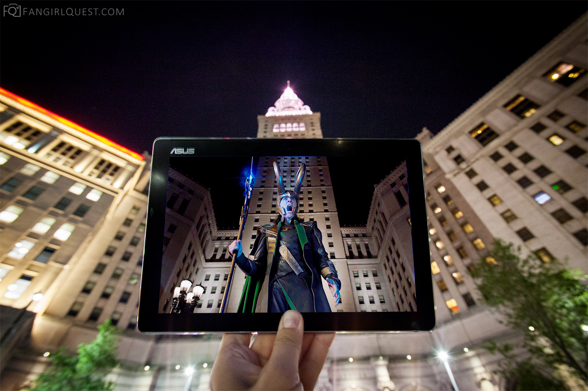
Cleveland in Science Fiction film
“Abbot and Costello Go To Mars” had its rocket lab in Cleveland
Howard the Duck (comic and movie – set in Cleveland but filmed in Iowa)
Buffy the Vampire Slayer (The other hellmouth)
Star Trek (Little Green Men)
Captain America: Winter Soldier, Captain America: Civil War filmed in part locally (local boys Anthony and Joe Russo, directors)
Charm City in TV show Powerless
Sharknado 4 (so much civic pride)

Slide 19
Questions?

